Slide 1
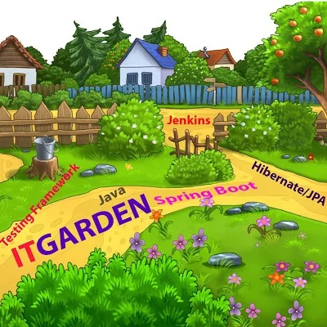
@SpringBootApplication
IT GARDEN
Enable Autoconfiguration
Performing Component Scan
Creating Application Context

Slide 2
IT GARDEN
Restful or Web Application Architecture
Presentation Layer (Rest Controller or Web Controller)
Service Layer
Data Access Layer
Presentation Layer @RestController or @Controller
Service Layer @Service and @Component
Data Access Layer @Repository CRUD
@Autowire
@Autowire
@Autowire

Slide 3
IT GARDEN
Spring important Annotation
@Controller
@RestController
@Service Annotation
@Component Annotation
@Qualifier Annotation
@Primary Annotation
@Repository Annotation @Transaction Annotation

Slide 4
IT GARDEN
CustomerController.java EmployeeController.java
CustomerService.java
EmployeeService.java
DataHandler.java
Presentation Layer @RestController or @Controller
Service Layer @Service and @Component
Data Access Layer @Repository CRUD
@Autowired

Slide 5
IT GARDEN
@Qualifier Annotation
If more than one bean of same type is available spring don’t know which bean to assign so spring throws a non unique exception. To avoid this issue we need to use @Qualifier Annotation
@Primary Annotation
If more than one bean of same type is available, we can tell Spring Framework by default assign to particular type so, whenever start the Spring Framework , by default assign to once class type.

